Slide 1
Lesson objective
Need whiteboards and calculators.
Title: Experimental probability
Aim:
Assign experimental probability base on experiments
Determine expected outcomes from probability
Plan:
Theoretical probability
Expected outcomes

Slide 2
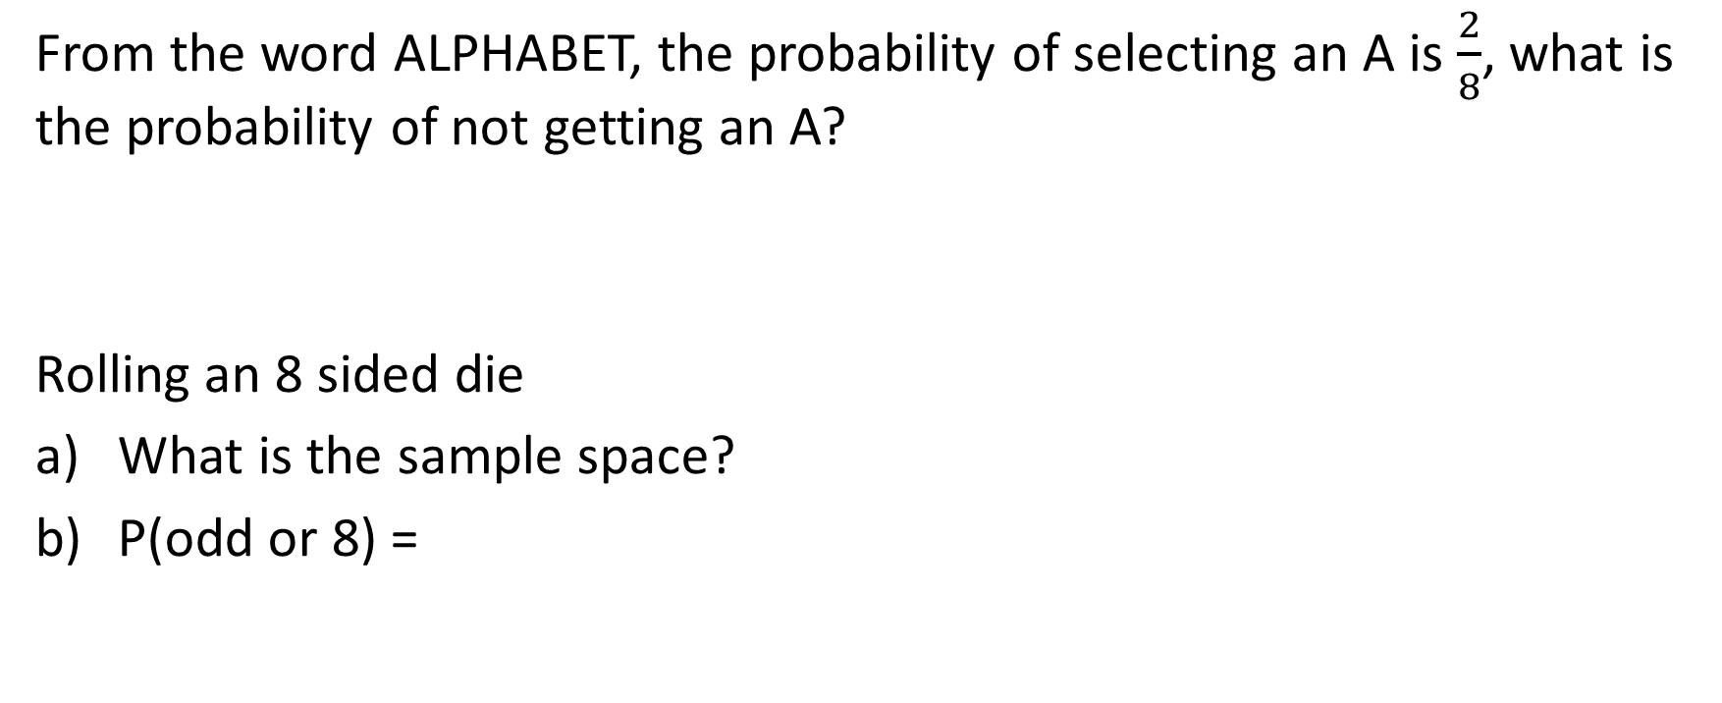
Daily review
From the word ALPHABET, the probability of selecting an A is $\frac{2}{8}$, what is the probability of not getting an A?
Rolling an 8 sided die
What is the sample space?
P(odd or 8) =

Slide 3
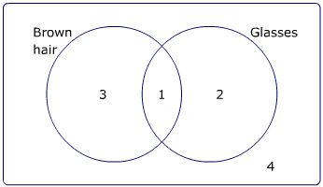
Venn to two-way tables
U =
 | Glasses |  | Total
Brown hair
Total

Slide 4
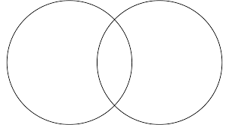
Whiteboards
U =
Football
Soccer
 | Football | Not football | Total
Soccer
Not soccer
Total
15
5
10
5

Slide 5
Whiteboards
U =
 | Surfing
Skate
Surfing
Skate
21
9
15
6

Slide 6
Theoretical and experimental
Theoretical
What we think should happen
Experimental
What actually happens in an experiment

Slide 7
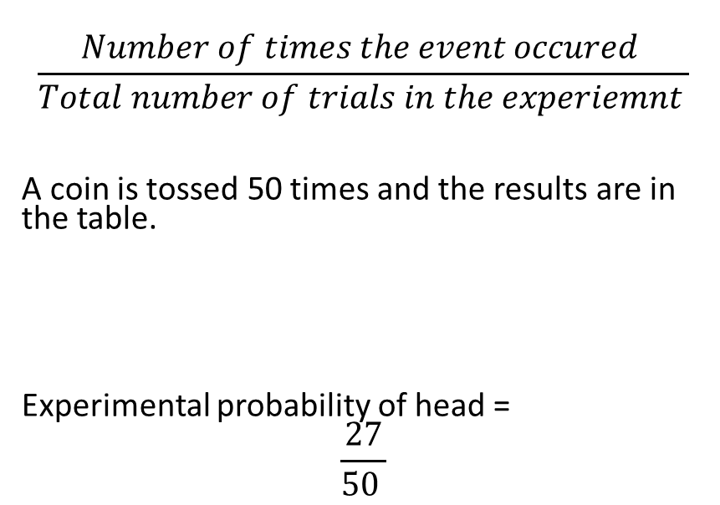
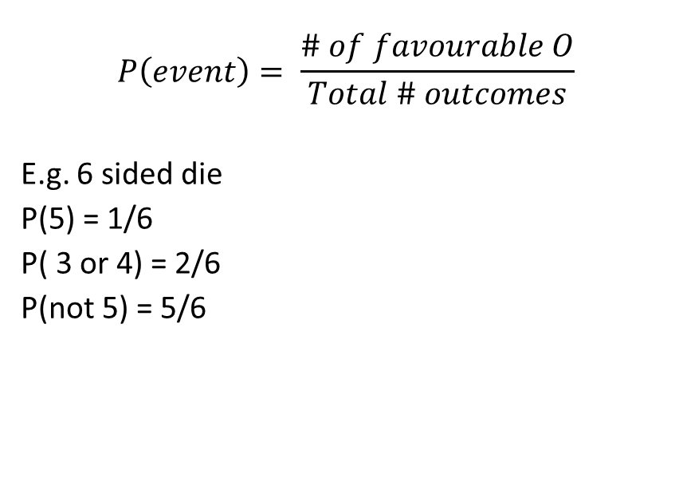
The difference
Theoretical probability
Experimental probability
$$P\left(event\right)= \frac{\# of favourable O}{Total \# outcomes}$$
E.g. 6 sided die
P(5) = 1/6
P( 3 or 4) = 2/6
P(not 5) = 5/6
$$\frac{Number of times the event occured }{Total number of trials in the experiemnt }$$
A coin is tossed 50 times and the results are in the table.
Experimental probability of head =
$$\frac{27}{50 }$$
Outcome | Heads | Tails
Frequency | 27 | 23

Slide 8
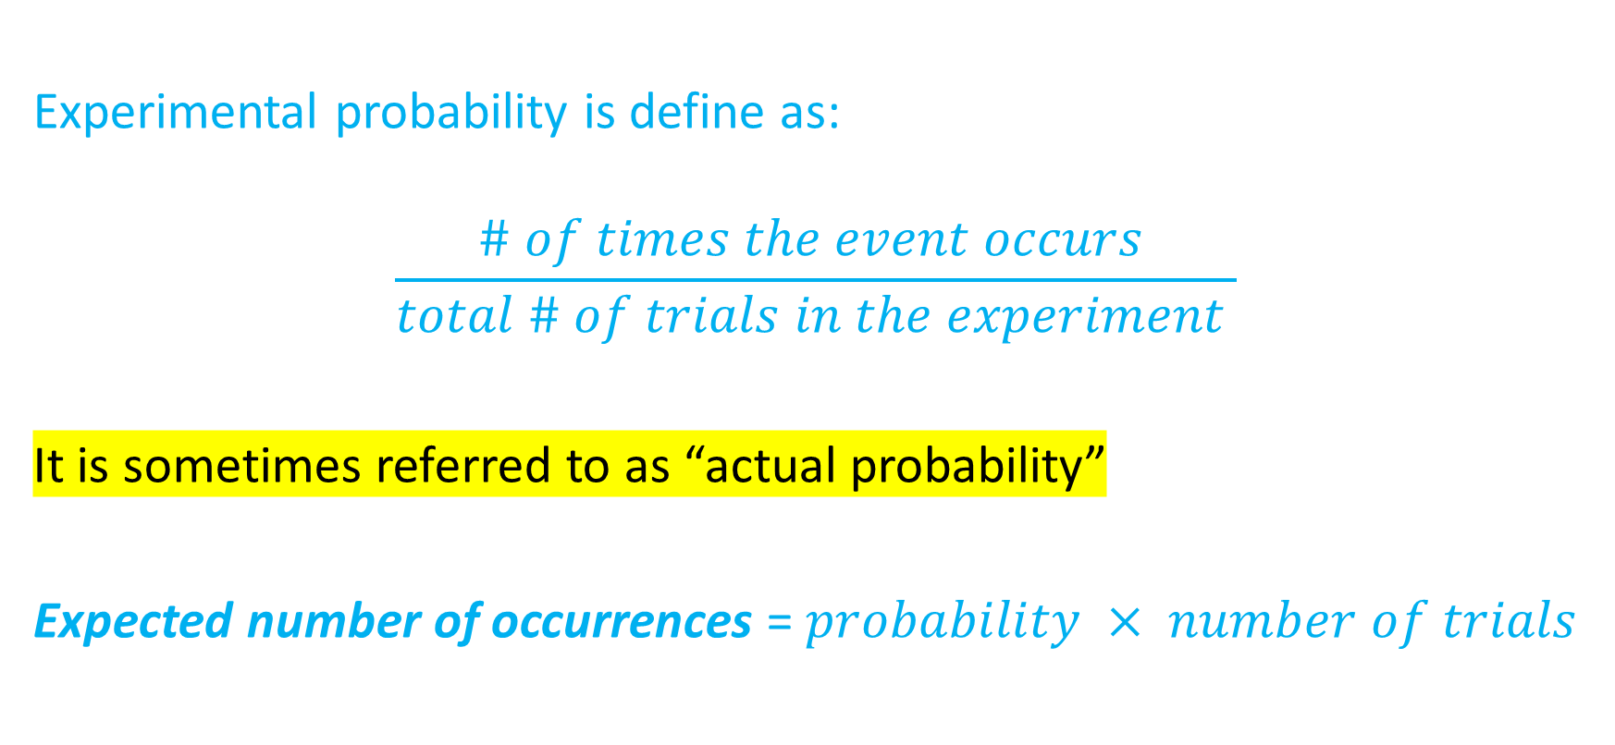
Quick notes
Experimental probability is define as:
$$\frac{\# of times the event occurs }{total \# of trials in the experiment }$$
It is sometimes referred to as “actual probability”
Expected number of occurrences = $probability × number of trials$

Slide 9
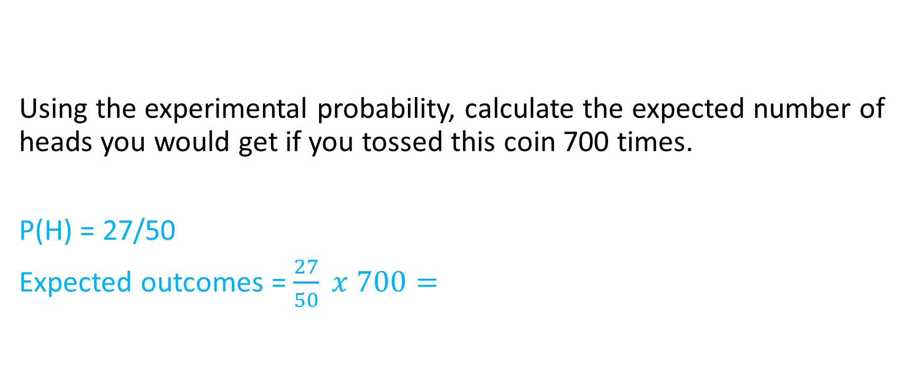
Example for notes
Outcome | Heads | Tails | Total
Frequency | 27 | 23 | 50
Using the experimental probability, calculate the expected number of heads you would get if you tossed this coin 700 times.
P(H) = 27/50
Expected outcomes = $\frac{27}{50} x 700=$

Slide 10
We do
A 6 sided die was rolled 100 times and the results are recorded below.
What is the experimental probability of a 5?
Using the experimental probability, calculate the number of 5s you would expect to get after 750 rolls.
Using the actual probability, calculate how many 5s you would expect after 750 rolls.
Outcome | 1 | 2 | 3 | 4 | 5 | 6 | Total
Frequency | 11 | 6 | 16 | 20 | 30 | 17 | 100

Slide 11
Individual practice
Page 392
Questions 5 – 9
Skip question 10
Continue 11 – 13

